Slide 1
Compressed EWK study(ISRC1N2)
Chengxin Liao
liaocx@ihep.ac.cn
Jun, Wed 4, 2025

Slide 2
Tasklist
Technical tool
Git and Docker(Pro Git, Docker Docs)
With a few cpp assignments to practice https://github.com/courseworks
Exclusion limit comparison between run2 and run2+run3 sample(HH, LH)
Compressed grid only have (100,80), (100,90)

Slide 3
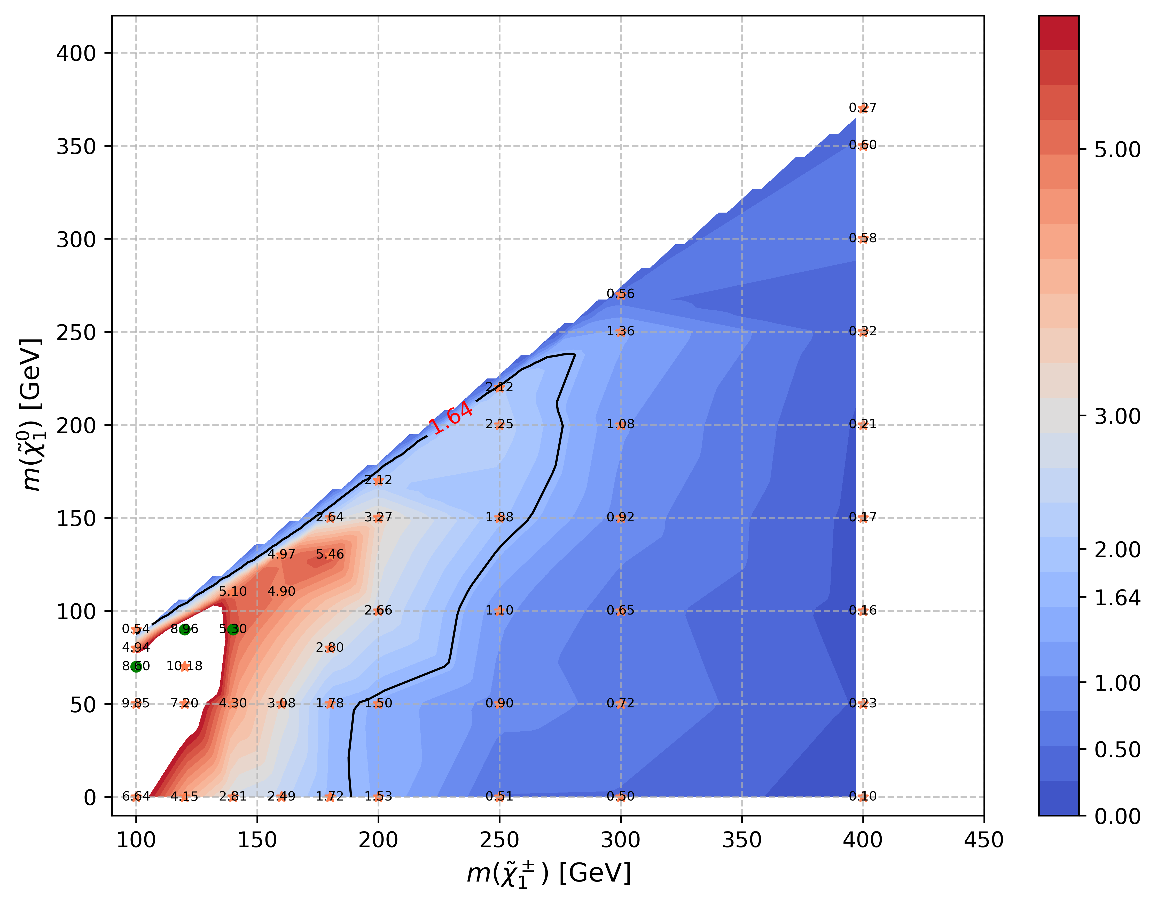
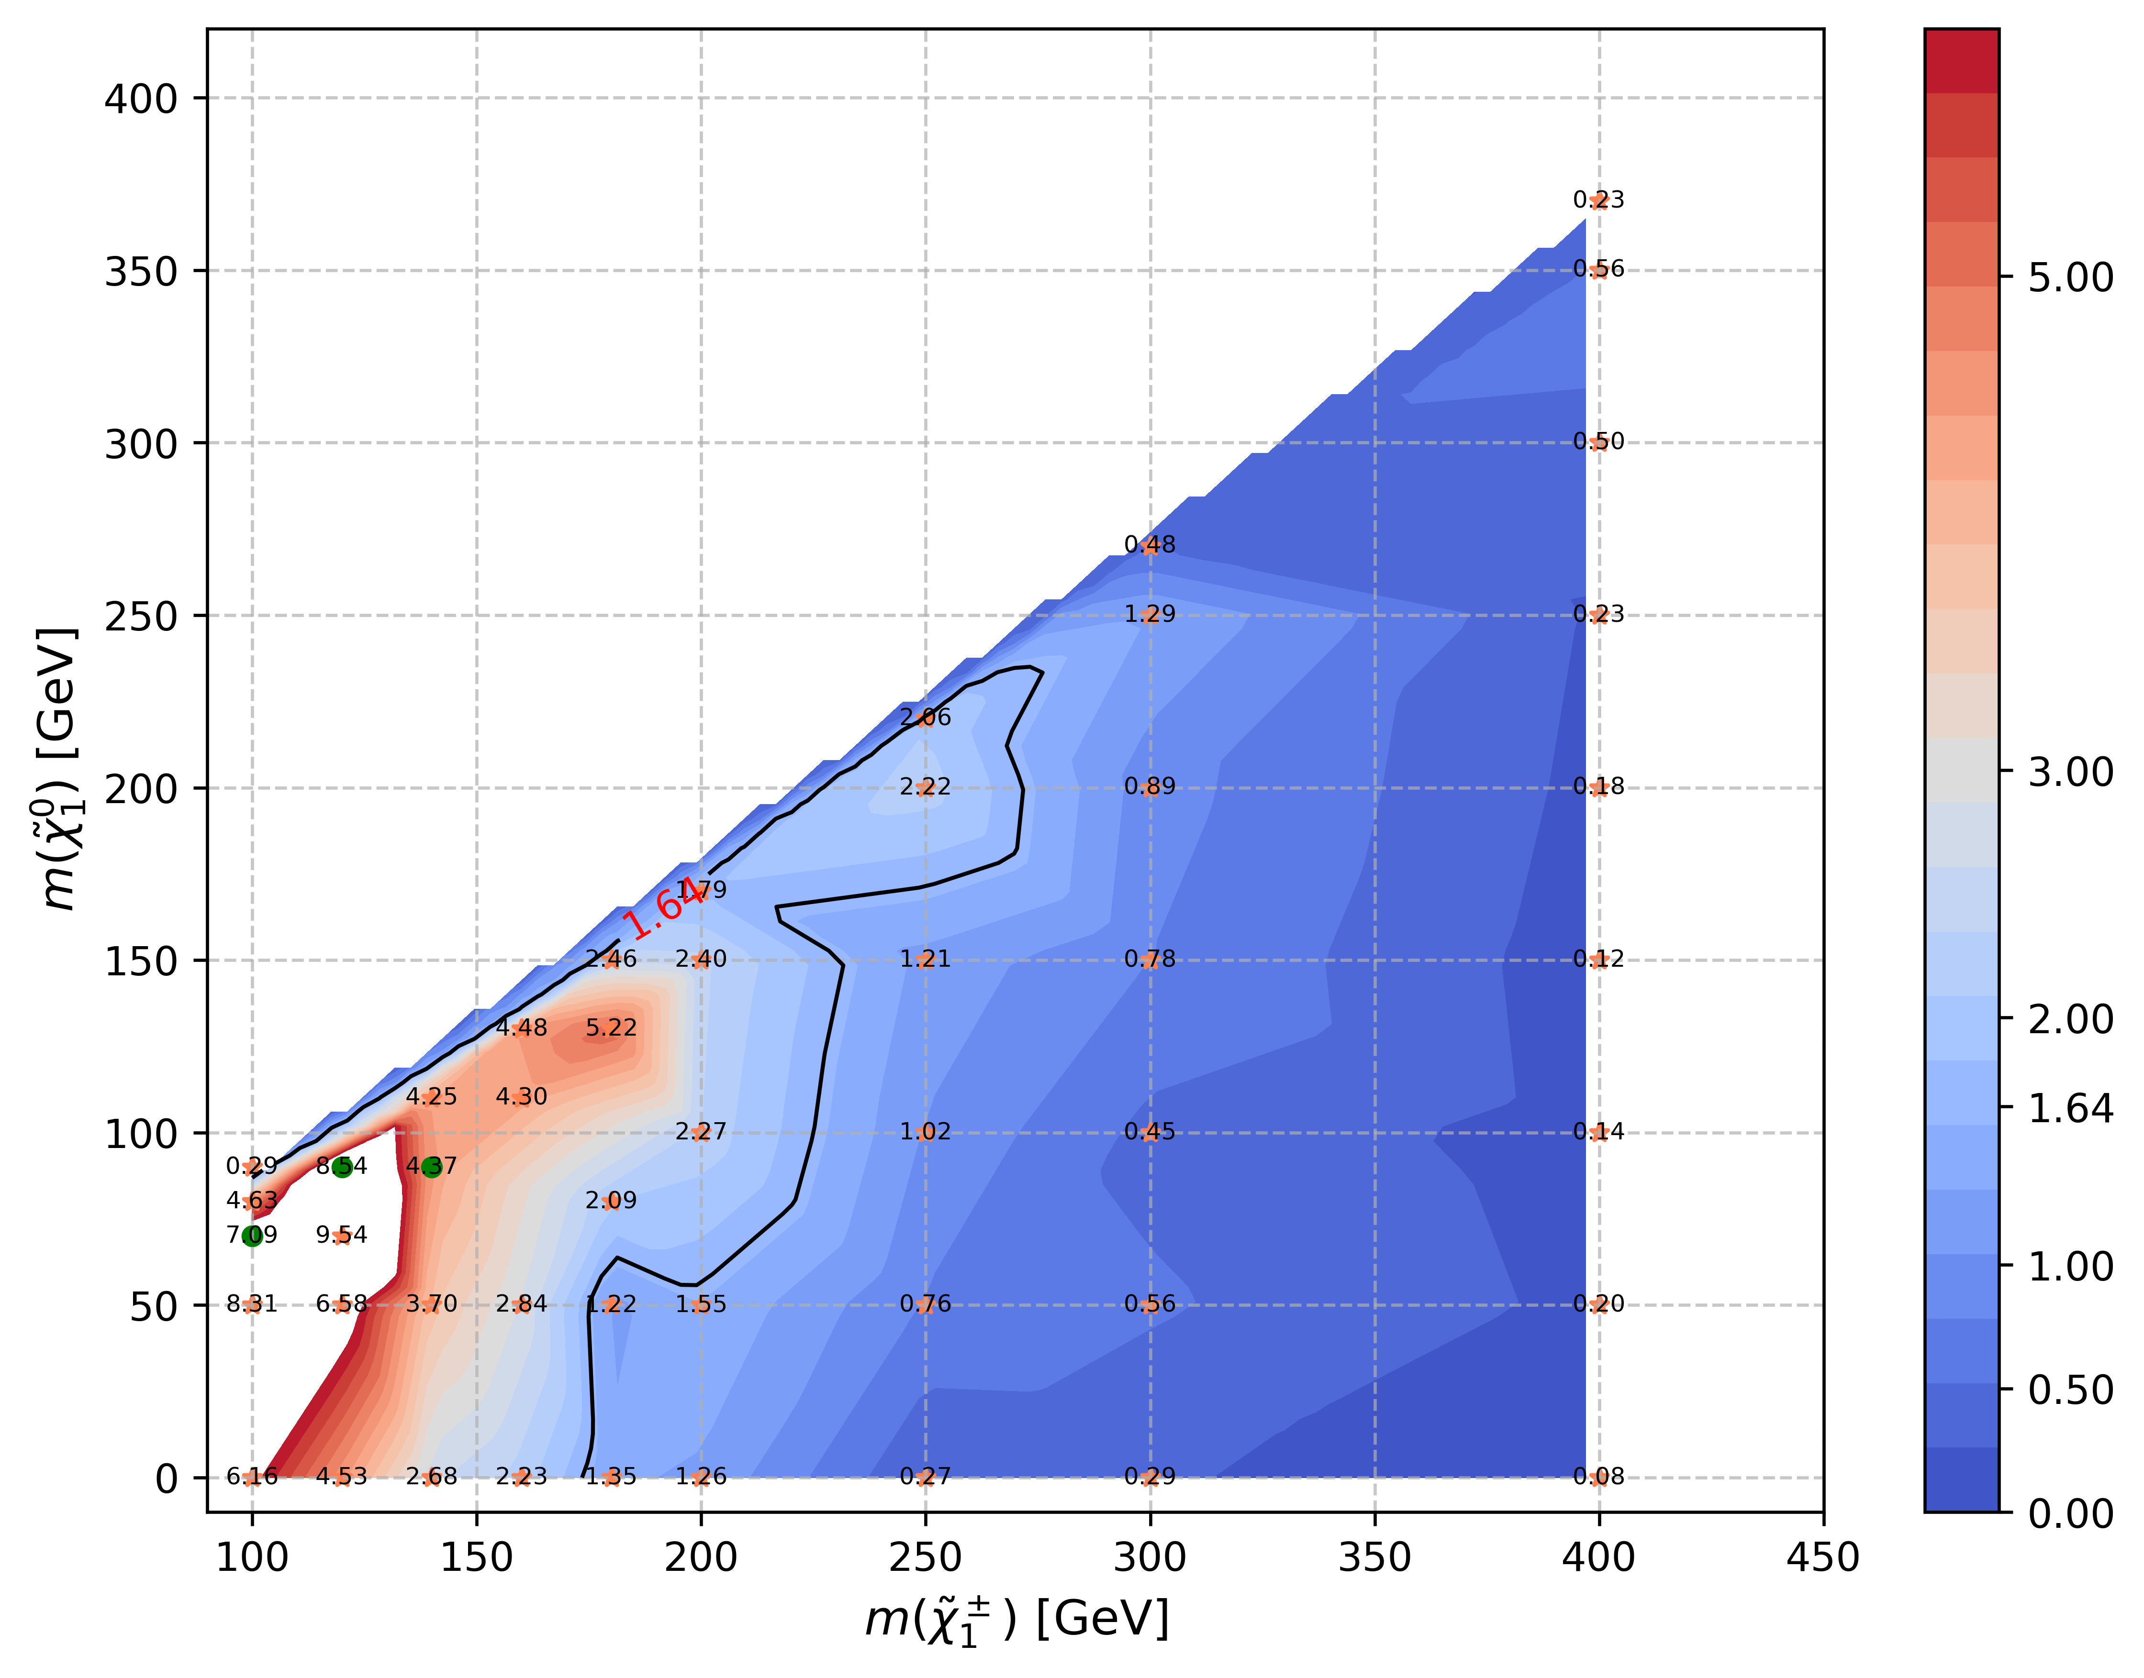


HH SR(include run2+partial run3)
Run2+Run3(partial) with multi signal training
Run2 with multi signal training
Run2+Run3(partial) with only one siganl
Run2 with only one signal training
Include signal: 100_70, 120_90, 140_90

Slide 4
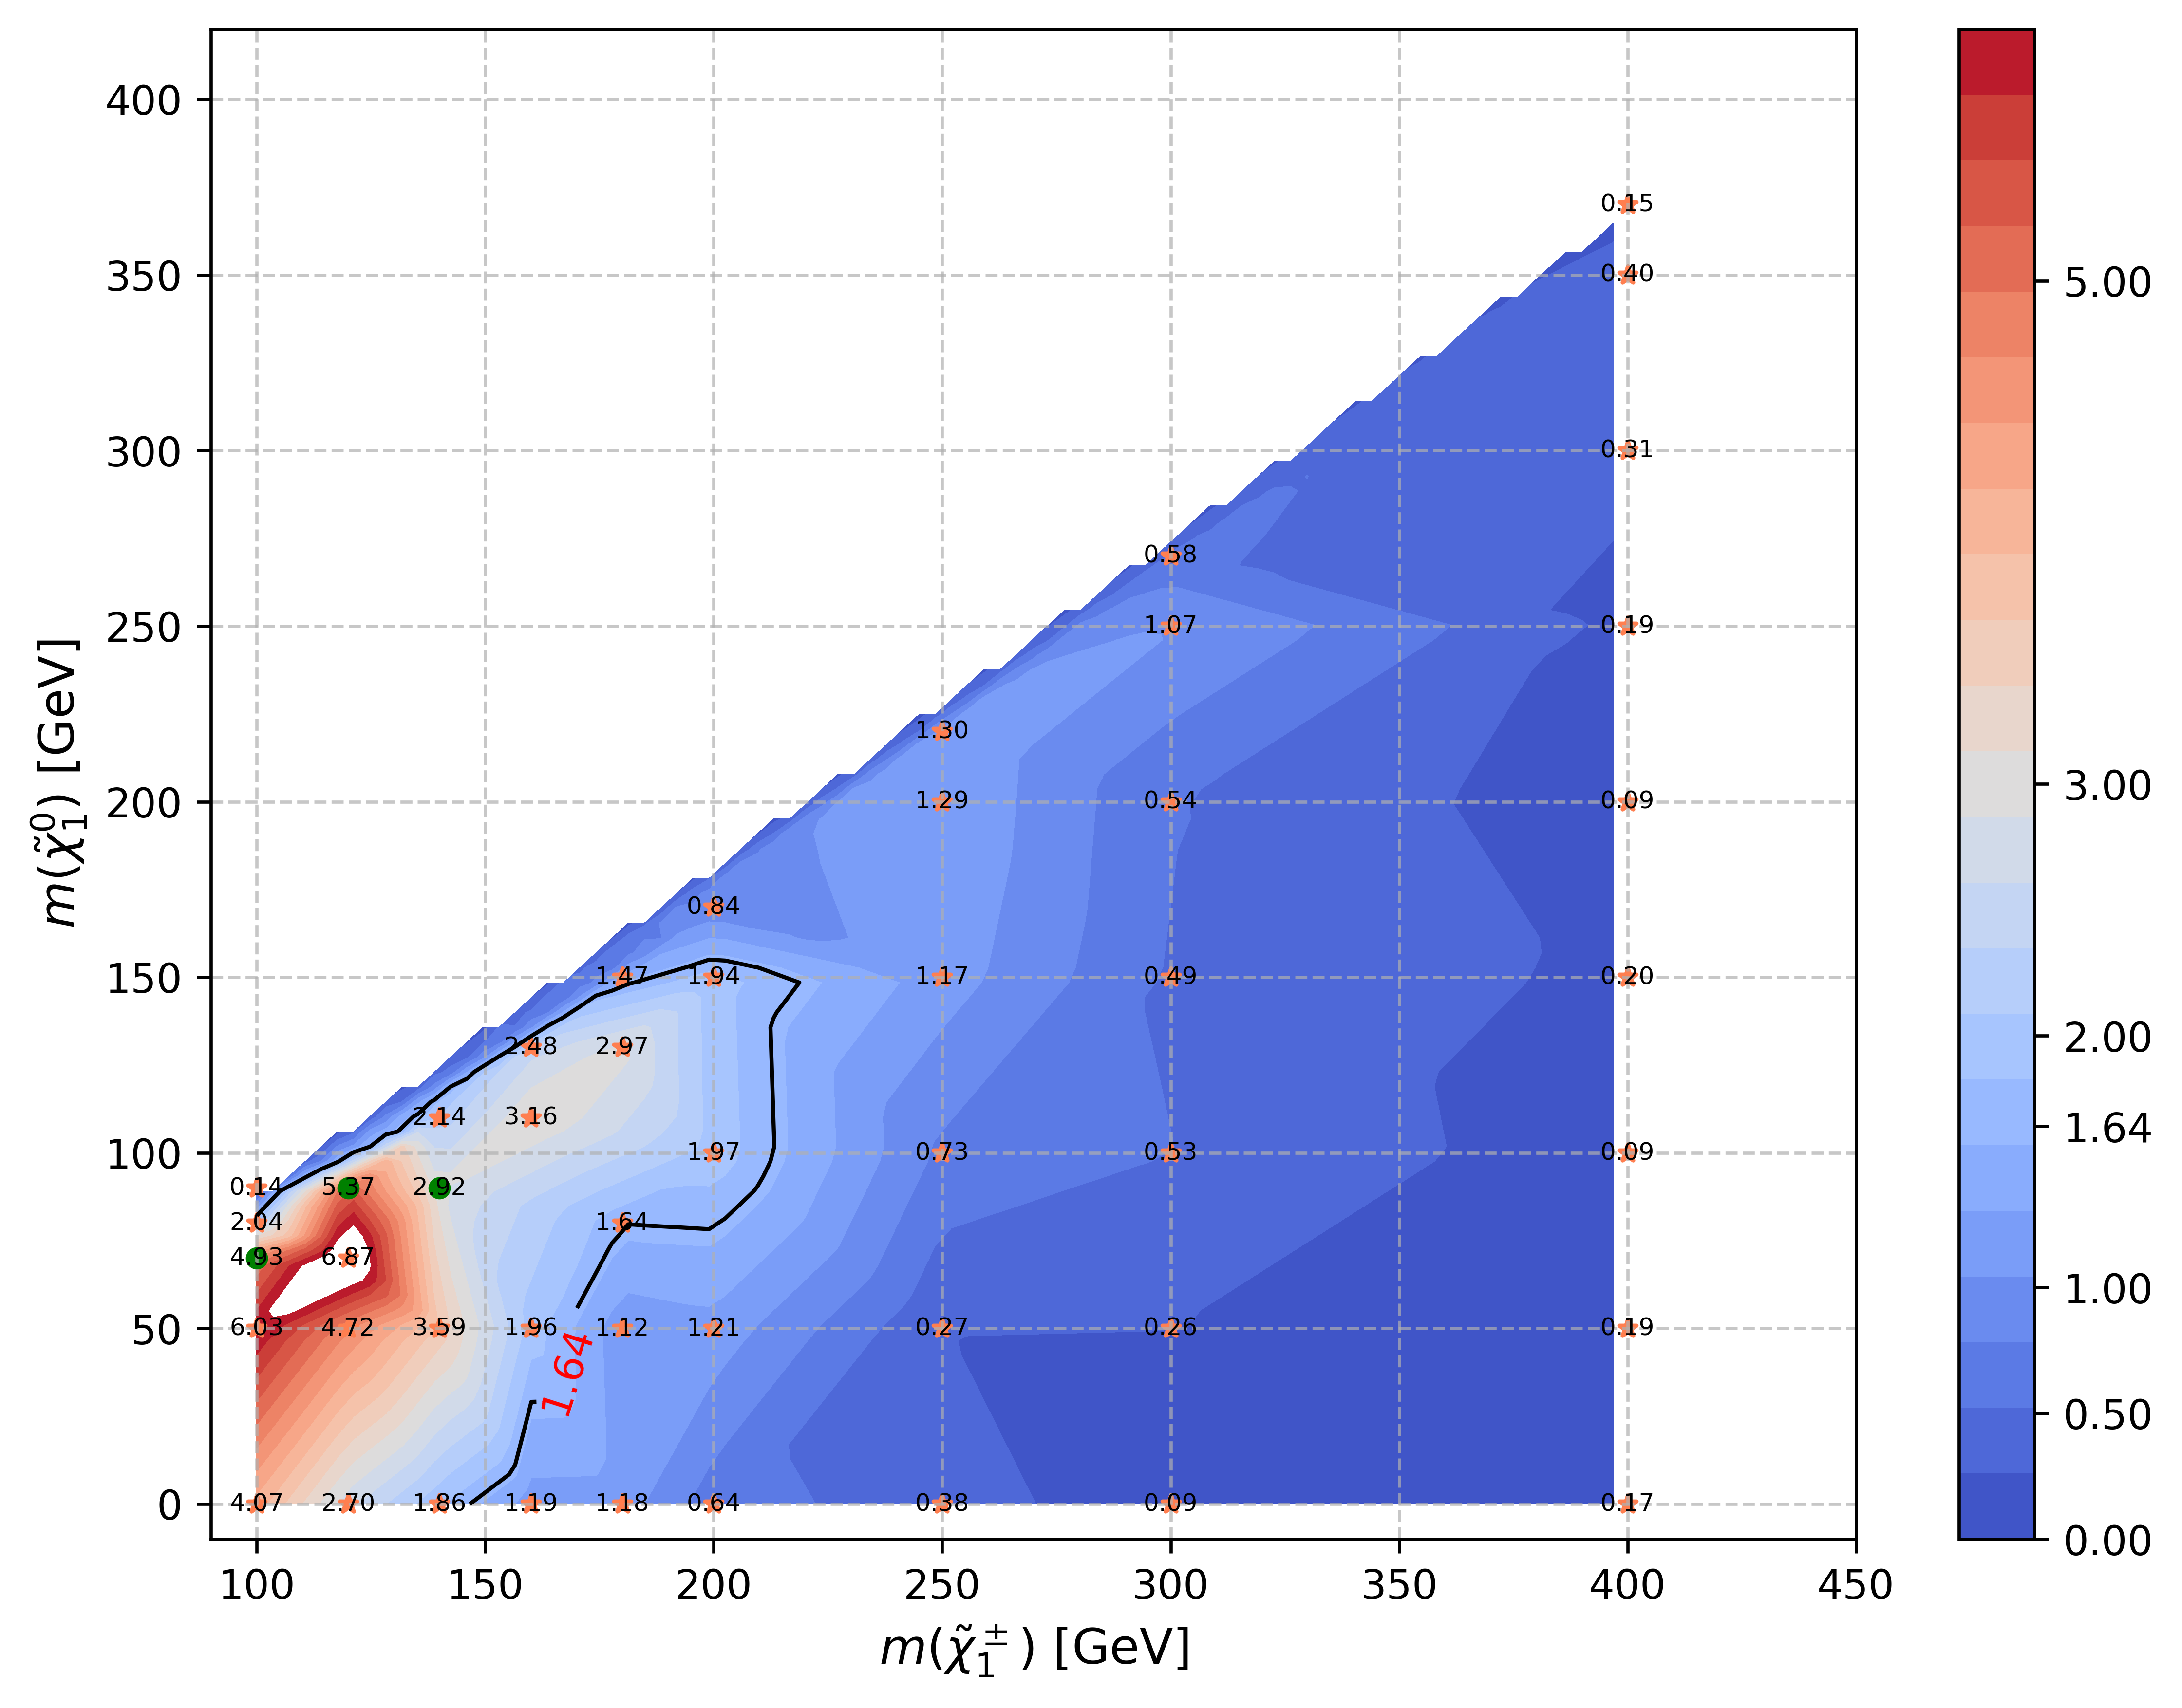
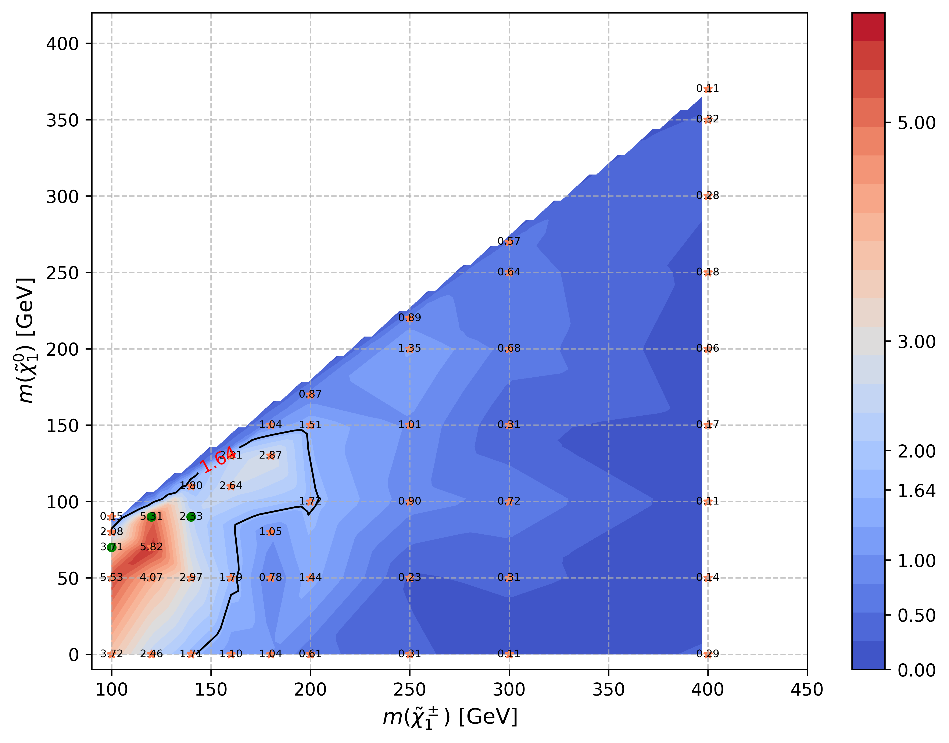
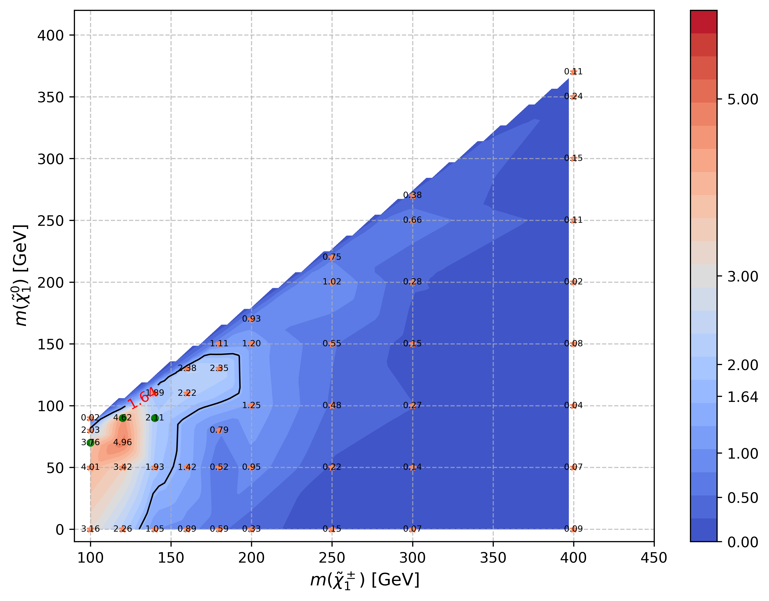
LH SR(include run2+partial run3)
Run2+Run3(partial) with multi signal training
Run2 with multi signal training
Run2+Run3(partial) with only one siganl
Run2 with only one signal training
Include signal: 100_70, 120_90, 140_90

